Slide 1
Bellwork 4 December 2018
What is irony? Can you find an example of irony in the room? Can you think of an example from something we have read this year, or an example at all?!
Can you name the three types of irony and explain/define them?
What is the difference between situational irony and circumstance?

Slide 2
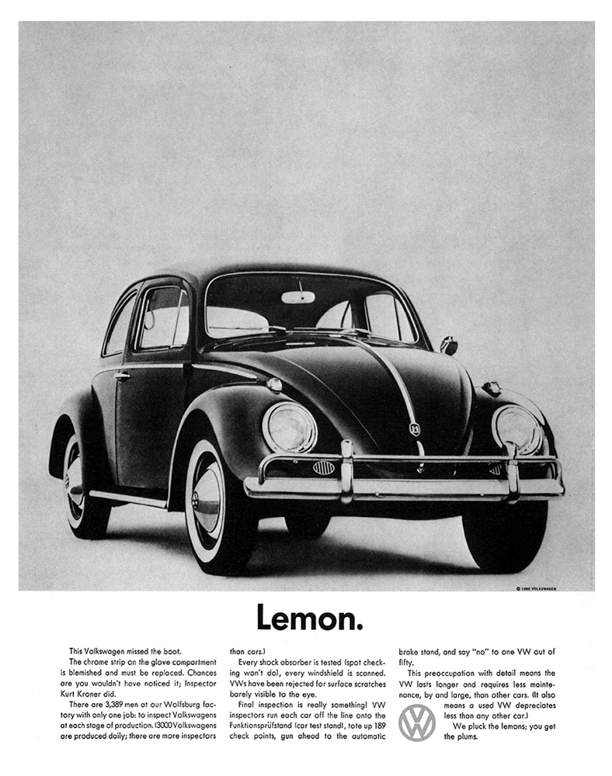

Slide 3
Irony
An incongruity between expectation and reality.
Verbal Irony: incongruity between what the speakers says and what he or she means
Dramatic Irony: a contrast between what a character says or thinks and what the audience (reader) know to be true.
Situational Irony: a discrepancy between what seems fitting and what actually happens

Slide 4
Situational Irony Examples
Seinfeld Pitch to NBC
Irony--The Opposite of What You Think (Expect)

Slide 5
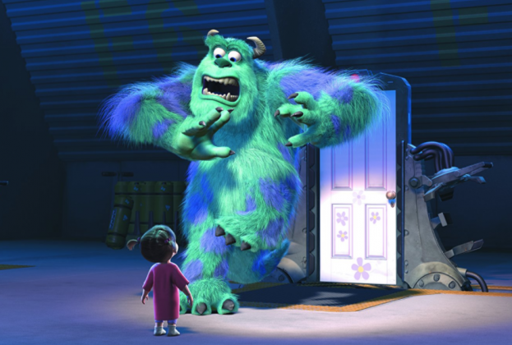

Slide 6
Purpose for Irony (Effect)
Playful
“Simple Task of Going to Post Office Feels Like Weight of 10,000 Boulders”
Satiric
“KFC No Longer Permitted to Use Word ‘Eat’ in Advertisements”
Sarcastic
“Teenage Rebels Seize Control of Food Court’s Corner Table”
To reveal hypocrisy or injustice, lobby for a social change, etc.

Slide 7
Ways to Create an Ironic Tone
Hyperbole: overstatement, but more so. It is an exaggeration in the service of truth. Like a well crafted metaphor, it should suggest a deeper meaning.
Caricature: a specific type of hyperbole: a representation in which he subject’s distinctive features are deliberately exaggerated to yield a comic or even grotesque effect.

Slide 8
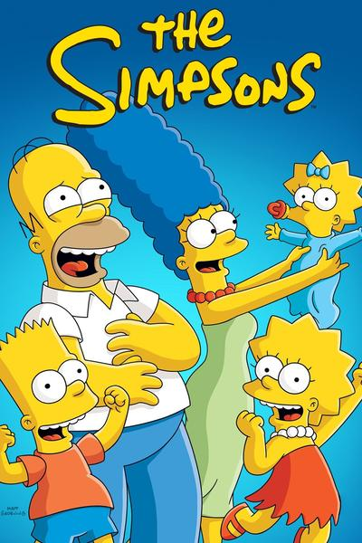

Slide 10
Ways to Create an Ironic Tone
Hyperbole: overstatement, but more so. It is an exaggeration in the service of truth. Like a well crafted metaphor, it should suggest a deeper meaning.
Caricature: a specific type of hyperbole: a representation in which he subject’s distinctive features are deliberately exaggerated to yield a comic or even grotesque effect.
In literature, caricatures may result in characters who are deliberately one dimensional, even stereotypes, yet if done skillfully, a caricature calls attention to a character’s faults.

Slide 11
Ways to Create an Ironic Tone
Understatement: opposite of hyperbole.
Often used to cloak a wry jab in politeness.
Juxtaposition: placing two ideas or words side by side to emphasize their incongruity is a key strategy for ironists.
Example could be juxtaposing something serious or philosophical with something trivial, as is done a lot in IOBE.
Wordplay: creates the humor that is essential to irony. Puns and double entendres (expressions with two meanings)
Non sequitur: a conclusion that does not follow logically from the premises
In literature, a non sequitur is a reply or remark that does not have any relevance to what preceded it.

Slide 12
Irony
A significant distance between what is said and what is true.

Slide 13
Objective
Exercise 1: Consider how Wilde creates irony and his purpose for doing so. Identify 5 examples and explain his use of irony/his purpose.

Slide 14
Exercise 2
Identify the ironic techniques of hyperbole, understatement, juxtaposition, wordplay, and non sequitur in the following excerpts:
Algernon: Why is it that at a bachelor’s establishment the servants invariably drink the champagne? I ask merely for information.
Lane: I attribute it to the superior quality of the wine, sir. I have often observed that in married households the champagne is rarely of a first-rate brand.
Lady Bracknell:…Do you smoke?
Jack: well, yes, I must admit I smoke.
Lady Bracknell: I am glad to hear it. A man should always have an occupation of some kind. There are too many idle men in London as it is.

Slide 15
Exercise 2
Identify the ironic techniques of hyperbole, understatement, juxtaposition, wordplay, and non sequitur in the following excerpts:
Gwendolen: Cecily Cardew? (Moving to her and shaking hands) What a very sweet name! Something tells me that we are going to be great friends. I like you already more than I can say. My first impressions of people are never wrong.
Cecily: How nice of you to like me so much after we have known each other such a coparatively short time. Pray sit down. Gwendolen (still standing up): I may call you Cecily, may I not.

Slide 16
Exercise 2
Identify the ironic techniques of hyperbole, understatement, juxtaposition, wordplay, and non sequitur in the following excerpts:
Jack: My dear Algy, you talk exactly as if you were a dentist. It is very vulgar to talk like a dentist when one isn’t a dentist. It produces a false impression.
Algernon: Well, that is exactly what dentists always do.

Slide 17
Bellwork 5 December 2018
Exercise 3: Explain how the Wilde uses irony to make a serious comment in each of the following excerpts.
Algernon: She will place me next Mary Farquhar, who always flirts with her own husband across the dinner table. That is not very pleasant. Indeed, it is not even decent—and that sort of thing is enormously on the increase. The amount of women in London who flirt with their own husbands is perfectly scandalous. It looks so bad. It is simply washing one’s clean linen in public.

Slide 18
Bellwork 5 December 2018
Exercise 3: Explain how the Wilde uses irony to make a serious comment in each of the following excerpts.
Lady Bracknell: London society is full of women of the very highest birth who have, of their own free choice, remained thirty-five for years. Lady Dumbleton is an instance in point. To my own knowledge she has been thirty-five since she arrived at the age of forty, which was many years ago now.

Slide 19
Bellwork 5 December 2018
Exercise 3: Explain how the Wilde uses irony to make a serious comment in each of the following excerpts.
Jack: I am sick to death of cleverness. Everybody is clever nowadays. You can’t go anywhere without meeting clever people. The thing has become an absolute public nuisance. I wish to goodness we had a few fools left.
Algernon: We have.
Jack: I should extremely like to meet them. What do they talk about?
Algernon: The fools? Oh! About the clever people, of course.
Jack: What fools!

Slide 20
Objective
Exercise 4: In her poem, “Siren Song” Margaret Atwood uses a number of strategies to develop an ironic tone, starting with the irony of the situation itself. Explain how the ironic tone, including some humor, conveys a serious message. Consider how Atwood prepares her reader for the final punch line.

