Slide 1
“Existentialism as Humanism”
Sartre
What does it mean to say that existence precedes essence? On what basis does Sartre hold there is no human nature (essence)?
Why does Sartre say that man is “condemned” to be free?
Whom does Sartre call “cowards”? To what extent do you agree or disagree with him?

Slide 2
Existentialism and Postmodernism

Slide 3
Is life worth living? –Camus

Slide 4

“The Myth of Sisyphus”

Slide 5
“Life is on the other side of despair.” –Sartre

Slide 6


Slide 7
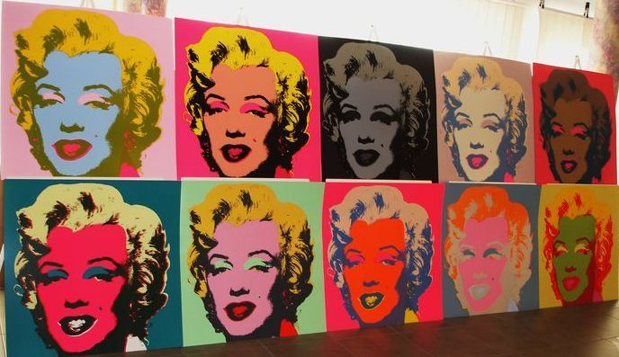

Slide 8


Slide 9


Slide 10


Slide 11
Elements of Postmodern Literature
Existentialism
Irony
Metafiction
Minimalism
Maximalism
Black humor
Pop culture references

Slide 12


Slide 13
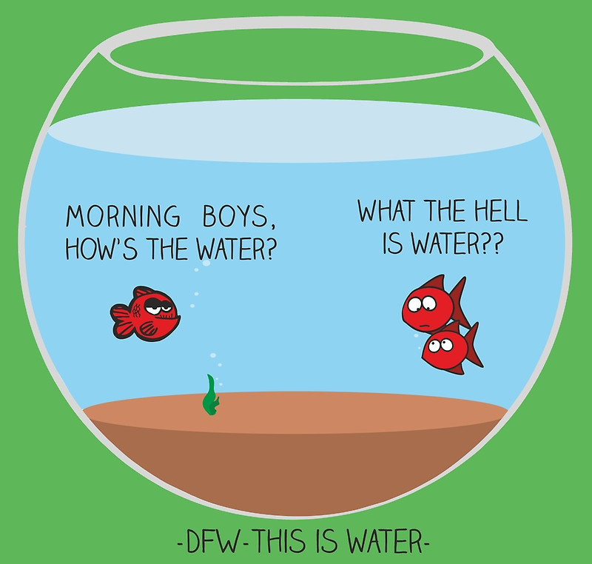
Bellwork
11 April 2019
‘This is water.’
‘This is water.’
What is the meaning of the “this is water” anecdote that opens and closes this address?

Slide 14
“This is Water” Discussion Questions
What conventions of the genre of the commencement address does Wallace mention? What is his attitude toward these conventions? To what degree does he follow them?
What does Wallace mean when he says that what’s important is not learning “how to think,” but learning “what to think about”? According to him, what do most people think about and pay attention to?

Slide 15
“This is Water” Discussion Questions
What is Wallace’s point of the “supermarket scenario” that he paints for the audience?
How do we develop our default settings?

Slide 16
“This is Water” Discussion Questions
How does Foster Wallace suggest we move past our “default setting”?
Does Wallace want people to feel guilty for being “the center of their own universe”? What details from the text support your answer?

Slide 17
“This is Water” Discussion Questions
What does Wallace mean when he says “everybody worships”? Why do you think he brings this point up in the speech?
If we aren’t considered to be mentally free, how did we get to be mentally trapped?

Slide 18
“This is Water” Discussion Questions
What assumptions does Wallace make of his intended audience (the graduates, and their families)?
Toward the end of the speech, Wallace tells us what he sees as the “most precious kind of freedom.” What is it? Do you think education can help us to develop this kind of freedom?

Slide 19
“This is Water” Discussion Questions
According to this text, what do you think Wallace sees as the value of a liberal arts education? What, in his view, does it teach students, or give them?
Is it possible that education isn’t the only way to become more aware of ourselves and others?

Slide 20
“This is Water” Discussion Questions
In this address, Wallace is both implicitly and explicitly critical of contemporary consumer society. Where is this evident? Why do you think he is critical of it?
Does Wallace say anything you disagree with, or that you can challenge or “push back” against?

Slide 21
“This is Water” Discussion Questions
Wallace gave this address in 2005, and culture, technology, politics, and education have all evolved a good deal since then? Is any part specific of his message more relevant or less relevant in the present moment, in your view? Why?
What elements of postmodernity does this speech address? OR what makes this a postmodern piece of writing? AND what elements of existentialism do you find in the piece? How would you connect it to our learning from Tuesday’s class?

