Slide 1
Student Data Sheet
Name two or three pieces of published fiction you’ve read that actually mean something to you. Explain what about each story gets to you so much, if you can.
From previous English classes, what was the best thing about the class? What were some not-so-good things about it?
Explain what you’d like to get out of this semester—like, what your consumer-expectations are. (It would help to be specific…and to be honest rather than just saying whatever it is you think the instructor wants to hear.)
How concerned are you about grades in this course? What do you expect your final grade to be based on? If you were the instructor for Honors English 9, what criteria would you use for grading?

Slide 2
Semester Overview
Heart of Darkness: Identity and Culture
HOD Essay
Free Response Timed Write
Style Project → Poetry Timed Write
Modernism: Ernest Hemingway, Franz Kafka
Existentialism: The European Existentialist Movement
Postmodernism
MC Final Exam

Slide 3
What You Need
A folder
A Notebook
Heart of Darkness, The Stranger, Waiting for Godot, White Noise

Slide 4
Final Course Grades
Notebook Check (Bellwork, Homework, Classwork, Notes): 10%
Attendance and Participation (Speaking and Listening): 20% + eligibility for grade curve
Major Writings/Assignments: 30%
Minipapers/Timed Writes: 20%
Reading Quizzes and other Assessments 20%

Slide 5
Late Work
-5% to major papers/other work
If work is excessively late (2 weeks or more), it may not be accepted at all.

Slide 6
Anticipatory Set
Do you feel that you create your identity or you inherit one? Is identity fixed or changing?
Do you find your true self or create your self?
Is defining identity based on difference a divisive or a constructive force in society?
Is there a real you?
What makes you, you? Brainstorm

Slide 7
TED Talk—Is There a Real You?

Slide 8
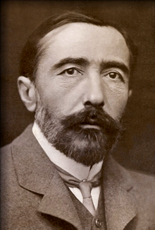
Heart of Darkness (1899)
Joseph Conrad (1857-1924)
Born to Polish parents living in the Russian-occupied Ukraine
Considered one of the finest British writers.
Did not become fluent in English until in his twenties.
Parents died at 9 and was raised by uncle
At 17, to avoid conscription into Russian army, he joined French merchant marines and began a fifteen-year career as a seaman.

Slide 9
Heart of Darkness (1899)
Joseph Conrad (1857-1924)
In 1889, Conrad served as captain for a steamboat traveling up the Congo River, fulfilling his childhood wish to visit Africa.
Contracted an illness that affected him for the rest of his life.

Slide 10
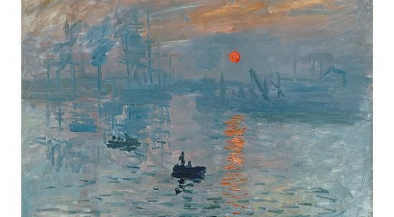
Heart of Darkness (1899)

Slide 11
Impressionism in HOD
Conrad creates an emotional landscape—a descriptive response of the character, and thereby the reader, to a specific setting or event in the story.
This type of writing is intentionally ambiguous.
‘In the moment’ approach
Marlow gives his impression; we, the reader, are left to make an interpretation.

Slide 12
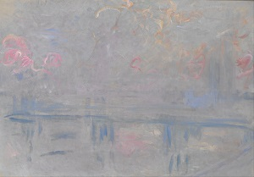
Impressionism in HOD
“…to me it seemed as though the mist itself had screamed, so suddenly, and apparently from all sides at once, did this tumultuous and mournful uproar arise. It culminated in a hurried outbreak of almost intolerably excessive shrieking, which stopped short, leaving us stiffened in a variety of silly attitudes, and obstinately listening to the nearly as appalling and excessive silence.”

Slide 13
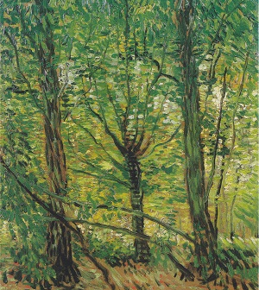
Impressionism in HOD
“…I saw a face amongst the leaves on the level with my own, looking at me very fierce and steady; and then suddenly, as though a veil had been removed from my eyes, I made out, deep in the tangled gloom, naked breasts, arms, legs, glaring eyes—the bush was swarming with human limbs in movement, glistening of bronze colour. The twigs shook, swayed, and rustled, the arrows flew out of them, and then the shutter came to.”

Slide 14
HOD Frame Narrative

Slide 15
Student Data Sheet
Name two or three pieces of published fiction you’ve read that actually mean something to you. Explain what about each story gets to you so much, if you can.
From previous English classes, what was the best thing about the class? What were some not-so-good things about it?
Explain what you’d like to get out of this semester—like, what your consumer-expectations are. (It would help to be specific…and to be honest rather than just saying whatever it is you think the instructor wants to hear.)
How concerned are you about grades in this course? What do you expect your final grade to be based on? If you were the instructor for Honors English 9, what criteria would you use for grading?

Slide 16
Heart of Darkness (1899)
Joseph Conrad (1857-1924)
Born to Polish parents living in the Russian-occupied Ukraine
Considered one of the finest British writers.
Did not become fluent in English until in his twenties.
Parents died at 9 and was raised by uncle
At 17, to avoid conscription into Russian army, he joined French merchant marines and began a fifteen-year career as a seaman.

Slide 17
Heart of Darkness (1899)
Joseph Conrad (1857-1924)
In 1889, Conrad served as captain for a steamboat traveling up the Congo River, fulfilling his childhood wish to visit Africa.
Contracted an illness that affected him for the rest of his life.

Slide 18
Quote Analysis
“The yarns of seaman have a direct simplicity, the whole meaning of which lies within the shell of a cracked nut. But Marlow was not typical (if his propensity to spin yarns be accepted) and to him the meaning of an episode was not inside like a kernel but outside, enveloping the tale which brought it out only as a glow brings out a haze, in the likeness of one of these misty halos that, sometimes, are made visible by the spectral illumination of moonshine.”

Slide 19
HOD Frame Narrative

Slide 20
Heart of Darkness (1899)

Slide 21
Impressionism in HOD
Conrad creates an emotional landscape—a descriptive response of the character, and thereby the reader, to a specific setting or event in the story.
This type of writing is intentionally ambiguous.
‘In the moment’ approach
Marlow gives his impression; we, the reader, are left to make an interpretation.

Slide 22
Impressionism in HOD
“…to me it seemed as though the mist itself had screamed, so suddenly, and apparently from all sides at once, did this tumultuous and mournful uproar arise. It culminated in a hurried outbreak of almost intolerably excessive shrieking, which stopped short, leaving us stiffened in a variety of silly attitudes, and obstinately listening to the nearly as appalling and excessive silence.”

Slide 23
Impressionism in HOD
“…I saw a face amongst the leaves on the level with my own, looking at me very fierce and steady; and then suddenly, as though a veil had been removed from my eyes, I made out, deep in the tangled gloom, naked breasts, arms, legs, glaring eyes—the bush was swarming with human limbs in movement, glistening of bronze colour. The twigs shook, swayed, and rustled, the arrows flew out of them, and then the shutter came to.”

Slide 24
Anticipatory Set
Do you feel that you create your identity or you inherit one? Is identity fixed or changing?

Slide 25
TED Talk—Is There a Real You?

Slide 26
Semester Overview
Heart of Darkness: Identity and Culture
HOD Essay
Free Response Timed Write
Style Project → Poetry Timed Write
Modernism: Ernest Hemingway, Franz Kafka
Existentialism: The European Existentialist Movement
Postmodernism
MC Final Exam

Slide 27
What You Need
A folder
A Notebook
Heart of Darkness, The Stranger, Waiting for Godot, White Noise

Slide 28
Final Course Grades
Notebook Check (Bellwork, Homework, Classwork, Notes): 10%
Attendance and Participation (Speaking and Listening): 20% + eligibility for grade curve
Major Writings/Assignments: 30%
Minipapers/Timed Writes: 20%
Reading Quizzes and other Assessments 20%

Slide 29
Late Work
-5% to major papers/other work
If work is excessively late (2 weeks or more), it may not be accepted at all.

Slide 30
BW 9 January 2019
Describe impressionism in writing. What is the purpose of it? What does it do to the reader? Based off lecture yesterday, what is Conrad’s purpose for writing this way in HOD? Finally, find an example of it from the outer frame: give a quotation, and analyze it. What is he doing as a writer stylistically—diction, imagery, syntax, figurative language—to create an impression rather than a literal depiction of scene.
Define framed narrative. What is the purpose of writing with this type of narration?

Slide 31
Impressionism in HOD
Conrad creates an emotional landscape—a descriptive response of the character, and thereby the reader, to a specific setting or event in the story.
This type of writing is intentionally ambiguous.
‘In the moment’ approach
Marlow gives his impression; we, the reader, are left to make an interpretation.

Slide 32
Impressionism in HOD
“…to me it seemed as though the mist itself had screamed, so suddenly, and apparently from all sides at once, did this tumultuous and mournful uproar arise. It culminated in a hurried outbreak of almost intolerably excessive shrieking, which stopped short, leaving us stiffened in a variety of silly attitudes, and obstinately listening to the nearly as appalling and excessive silence.”

Slide 33
Objective & Purpose
Read “Heart of Darkness and the legacy of Colonialism” and answer questions referring to the map of Arica during colonialization and decolonization.
Gain context to HOD.

Slide 34
Objective
EQ: What makes us who we are?
Begin exploring our central theme for HOD—Identity and Culture—by reading an introduction and the short story, “Where Are You Going, Where Have You Been?” (1966) by Joyce Carol Oates.

Slide 35
